Slide 1


NETFLIX CONTENT STRATEGY
Focus on where it matters
MGMT 59000 – WDA
BAIM Analytica

Slide 2



MEET THE TEAM
MEENAKSHI BHAT
PRASHANTH SURESH
MRINMOY DALAL
VP, Strategy
VP, Analytics
VP, Marketing
BAIM ANALYTICA

Slide 3






AGENDA
Executive Summary
Business Scenario
Analysis
Insights, Actions, Impact
Limitations
Future Prospects

Slide 4
















EXECUTIVE SUMMARY
Key Question
How should Netflix strategize it’s investments on content to improve it’s subscriber base?
Challenges
Key Findings
Subscriptions based business model. No other significant revenue streams
Increasing competition from companies such as Disney+ and Amazon
Strong correlation between number of tv shows and number of subscribers
Netflix’s exclusive original content has a higher rating when compared to content on other platforms
TV shows account for only 30% of the library on Netflix
Crackdown on password sharing resulted in bleeding subscriber count
Consumers holding on to their money owing to price hike and rising inflation
Mean rating of shows with more that one season is higher than those with just one season
Only 29% of the TV shows on Netflix is original content
Recommendations
Impact
For every new TV introduced ➔ 0.7% increase in subscriber count
Future Prospects
Invest more into original TV show content
A/B testing to ascertain if changing the ratio of movies to tv shows in the content library has an impact on the subscriber base
Based on the search patterns and overall interest in kind of content, determine the best time to add older titles to the content library
License TV shows that have longer runs (more than one season)
Unit increase in critic score ➔ 0.52% increase in subscriber count

Slide 5
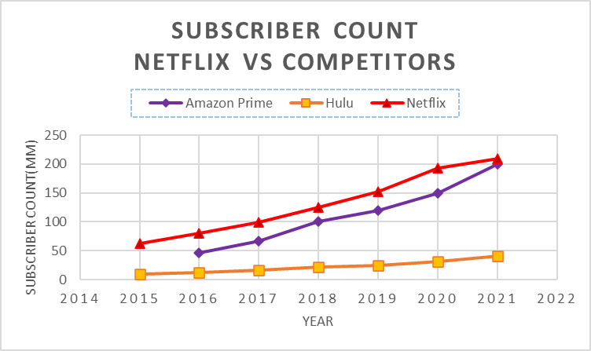
Business CONTEXT
Netflix is one of the world's leading entertainment services with more than 220 million paid memberships in over 190 countries enjoying TV shows, movies, documentaries, feature films across a wide range of genres and languages.
In Q2 of 2022, Netflix lost more than 970K users resulting in a subscribing count of 221M.
Stock hit an all-time low
Increased competition from newer players like Disney Plus, and Hulu
Threat of New Entrants

Slide 6
ANALYSIS & MODELING

Slide 7






DATA PROCESSING PIPELINE
COLLECTION
PRE-PROCESS
EDA
HYPOTHESIS TESTING
MODELING
INTELLIGENCE
Scrape Rotten Tomatoes
Datasets on Kaggle
Business of Apps
Tokenize
Lemmatize
Stopwords
Data Aggregation
T-test for two sample means assuming unequal variances
Log – Linear Model
Sentiment Analysis
Monetization of Content Strategy

Slide 8



Analysis – MARKET SIZE & CONTENT
Market Size
Content Presence
Highest market share in US and Canada
Number of subscribers in EMEA increasing
Only 30% of overall Netflix library consists of tv shows
Only 12% of movies are exclusive to Netflix compared to TV shows which is much higher

Slide 9


Analysis - COMPETITORS
Hulu has a higher proportion of TV shows in its library than Netflix.
With Disney acquiring Hulu, this becomes an extremely competitive landscape for Netflix
10% of TV shows and 9% of movies on Netflix are common across all platforms
But, TV shows exclusive to Netflix have better content rating
Average Content Rating:
53%
43%

Slide 10
Analysis
Correlation Analysis:
Movies Vs. Subscribers - 0.86
TV Shows Vs. Subscribers - 0.93
Proportionate increase in number of subscribers as number of TV shows grow.
4% growth experienced in Q4 2021, primarily attributed to new TV-series Squid game

Slide 11
INSIGHT, ACTIONS, IMPACT

Slide 12


KEY FEATURES
Feature | Relevance
Number of TV Shows
Number of new movies
Critic Rating
Customer Rating
Customer Sentiment
Number of new tv shows introduced and score given by critics have a higher impact on subscriber count
Number of new movies introduced and reviews from customers do not impact the subscriber count significantly

Slide 13
BUSINESS INSIGHTS
WHY SHOULD I CARE?
WHAT’S IN THE LIBRARY?
HOW MUCH IS ORIGINAL?
Strong correlation between number of tv shows and number of subscribers
TV shows account for only 30% of the library on Netflix
Only 29% of the TV shows on Netflix is original content
ARE MY ORIGINALS GOOD?
1 SEASON OR MORE?
Netflix’s exclusive original content has a higher rating when compared to content on other platforms
Mean rating of shows with more that one season is higher than those with just one season

Slide 14
STRATEGIC ACTIONS AND IMPACT
Focus on producing original TV shows- improves user acquisition ^{A}
Every new tv show introduced ➔ 0.70% increase in subscriber count
License TV shows that have longer runs (more than one season)- improves user retention ^{B}
Every one-point increase in critic score ➔ 0.5% increase in subscriber count
^{A} Original Tv shows has the ability to bring in new users
^{B} Research suggests majority of top 10 highest viewership time in hours comprises of tv shows that have more than 1 season

Slide 15

LIMITATIONS
LACK OF USER DATA
WEB SCRAPING
Unable to ascertain trends in metrics such as watch time, subscription tiers, genre preferences etc.
~50% of the titles available in the dataset did not have enough ratings and reviews to generate a score on Rotten Tomatoes
Effect of hidden variables such as CPI, and marketing efforts may lead to the correlation observed in the model
A model built with a carefully selected feature set is critical to provide a comprehensive understanding
CAUSATION
MODEL AND FEATURES

Slide 16


FUTURE PROSPECTS
A/B Testing to identify the right proportion of tv shows and movies across different regions
Analysing user search patterns to determine the best time to add historical content*
* The Office is the most-watched show on Netflix although it went off air in 2013

Slide 17
APPENDIX

Slide 18
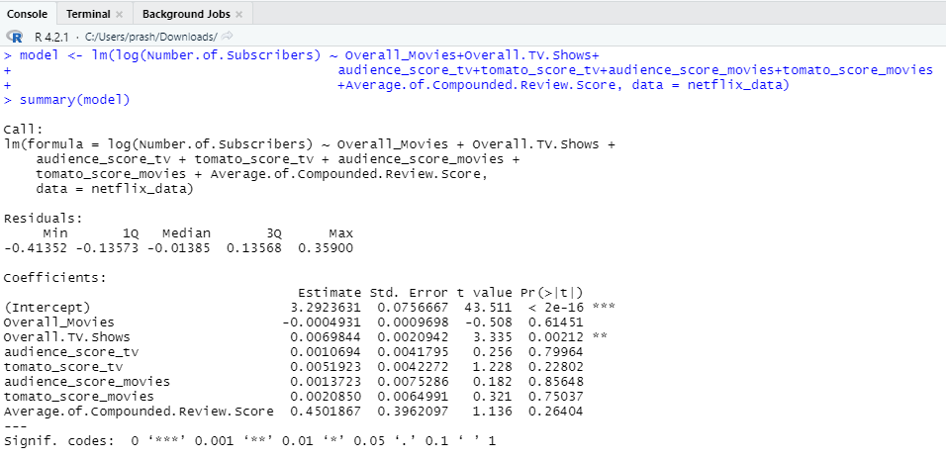
MODEL

Slide 19
Sentiment analysis scores
Across titles
Across type of content

Slide 20
THANK YOU

